Slide 1
PHP Basics
Damian Crisafulli
damian@troyweb.com

Slide 2

https://www.troyweb.com/

Slide 3
Agenda
Introduction to The Language Of The Web
Responsibilities of client side vs. server side code
PHP usage statistics
PHP history
Why learn PHP?
Where does PHP stand in 2017?
Real World Basics
The Development Environment
Composer
Namespacing + PSR4 Autoloading
Pro Tips
Next Steps
Challenge Problem

Slide 4
Client Side AKA The Front End
Code that runs on a user’s device!
Web browsers
Smartphones
Desktops/Laptops
Pretty much anything due to IoT

Slide 5
Server Side AKA The Back End
Code that runs on controlled infrastructure.
Primary Responsibilities (among other things):
Receive some sort of input from a client.
Take some sort of action based on that input.
Deliver feedback back to the client.

Slide 6
Server Side Web Languages
PHP
Ruby
Python
C#
Java
Groovy
Cold Fusion
JavaScript

Slide 7
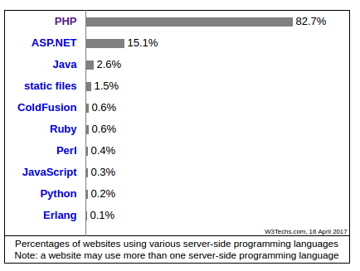
PHP Usage
https://w3techs.com/technologies/overview/programming_language/all

Slide 8
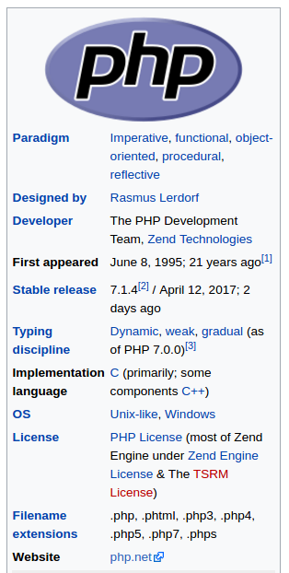
Reason 1
PHP was created for a specific purpose and has withstood the test of time serving that purpose.

Slide 9
Reason 2
Reason 2.5
PHP runtime environments are highly available and easy to setup.
The PHP language is very flexible and has a low barrier to entry.

Slide 10








Reason 3
Open-source PHP software

Slide 11
Where does PHP stand in 2017?
PHP 7.0 brought big performance improvements and modernized many aspects of the language.
More great features like JIT compiling planned for future releases.
Mature ecosystem of frameworks and open source software.
Used by many tech giants including Facebook, Slack, Cloudflare and Wikipedia.
PHP is a safe bet.

Slide 12
Real World Basics

Slide 13
The Development Environment

Slide 14
Web Server
[Apache](https://www.apache.org/)
[NGINX](https://nginx.org/)

Slide 15
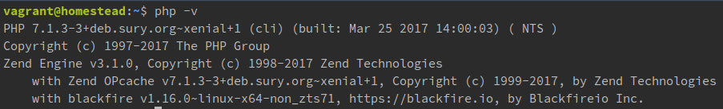
PHP
http://php.net/manual/en/install.php
Get the latest version! (7.1)

Slide 16
Database
[MySQL](https://www.mysql.com/)
[PostgreSQL](https://www.postgresql.org/)

Slide 17
Preconfigured Setup
[XAMPP](https://www.apachefriends.org/index.html)
[WAMP](http://www.wampserver.com/en/) (Windows only)
Vagrant (https://www.vagrantup.com/)
[Homestead](https://laravel.com/docs/5.4/homestead)
[Scotch Box](https://box.scotch.io/)

Slide 18
Editors
[Sublime Text](https://www.sublimetext.com/) (Shareware $70)
[PHP Storm](https://www.jetbrains.com/phpstorm/) (Subscription)

Slide 19
Environment Variables

Slide 20
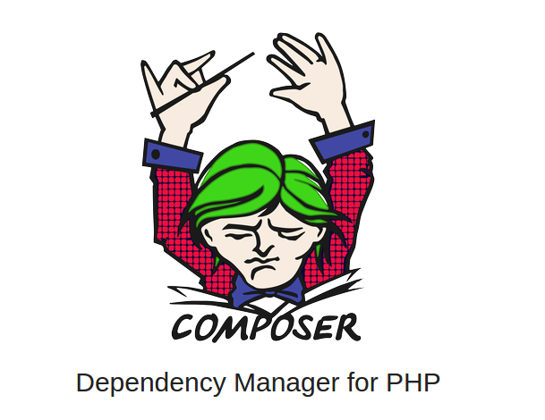
[Composer](https://getcomposer.org/)

Slide 21
What Is A Package?
[Packagist](https://packagist.org/)

Slide 22
The Importance Of Dependency Management
https://getcomposer.org/doc/00-intro.md

Slide 23
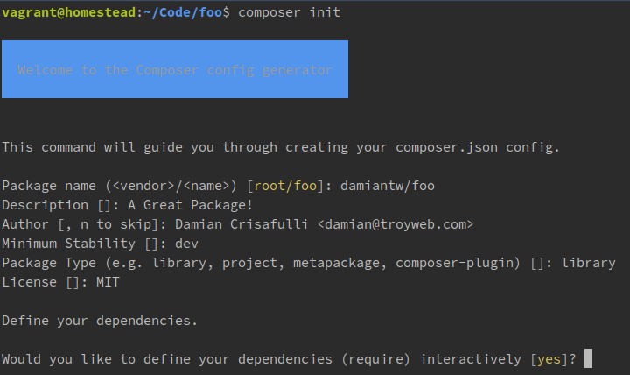
composer init

Slide 24
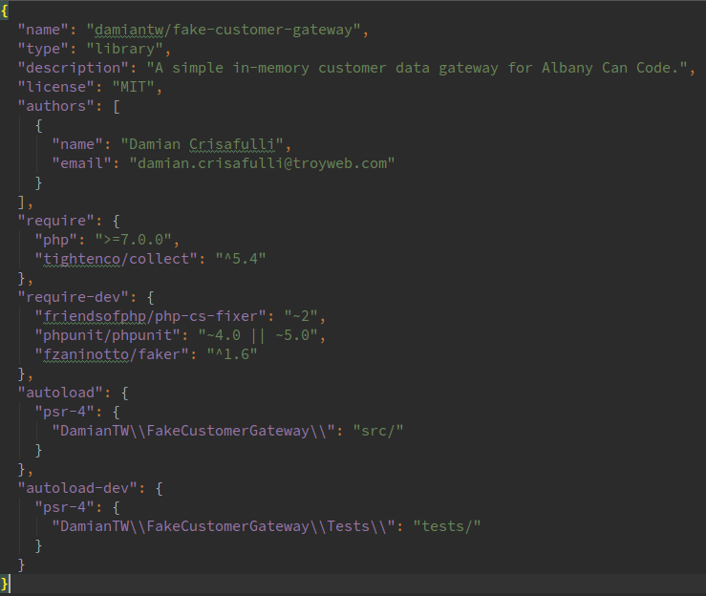
composer.json

Slide 25
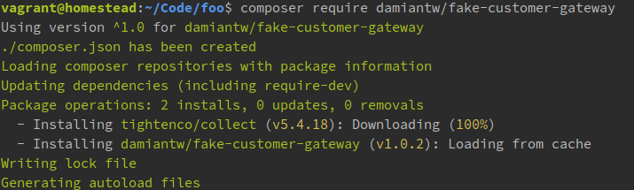

composer require damiantw/fake-customer-gateway
composer update

Slide 26
Namespacing
+
PSR4 Autoloading

Slide 27
PHP Include Functions
include
include_once
require
require_once

Slide 28
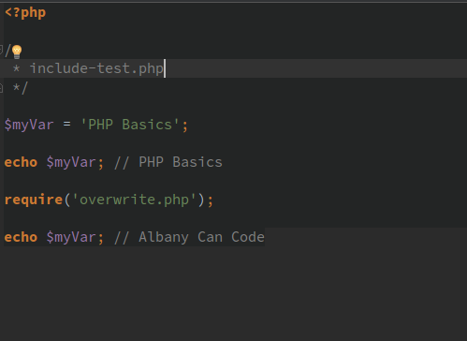
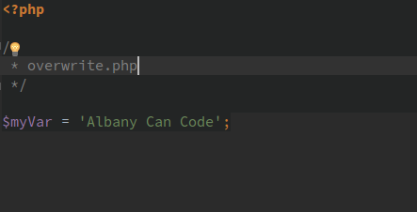

Slide 29
Issues
Potential for namespace collision if you are the file being required declares variables in the global scope.
Can be difficult to manage all of the needed include calls in large projects.

Slide 30
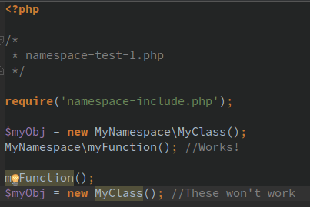
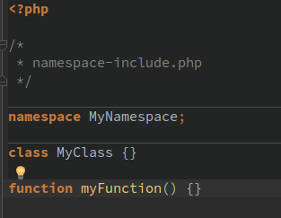
Namespacing

Slide 31
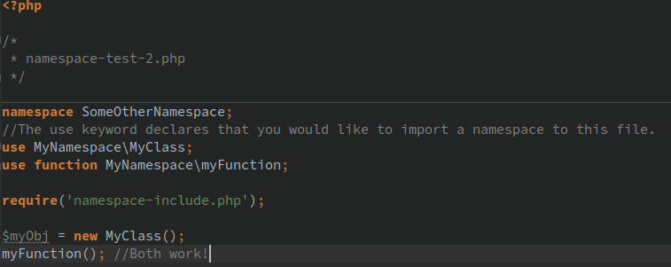
Namespacing (continued)

Slide 32
Autoloaders

Slide 33
PSR4 ELI5

Slide 34
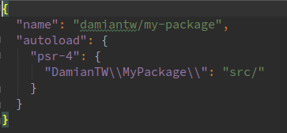
Declare Root Namespace
composer.json
Declaring top level namespace as DamianTW\MyPackage
src/ is project root

Slide 35
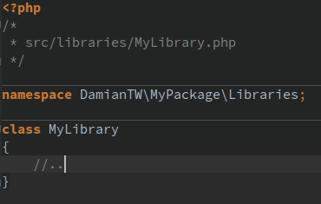
2.
All files in the projects should declare a namespace that corresponds to the file's path relative to the project root, prefixed with the top level namespace.

Slide 36
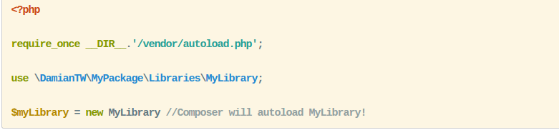
3.
The autoloader loads the file by looking at namespace.

Slide 37
Pro Tips

Slide 38
A Bit About Security
Prevent SQL injection with prepared statements.
Filter for XSS at the output level.
Use CSRF tokens to protect your forms.
Hash passwords with bcrypt.

Slide 39
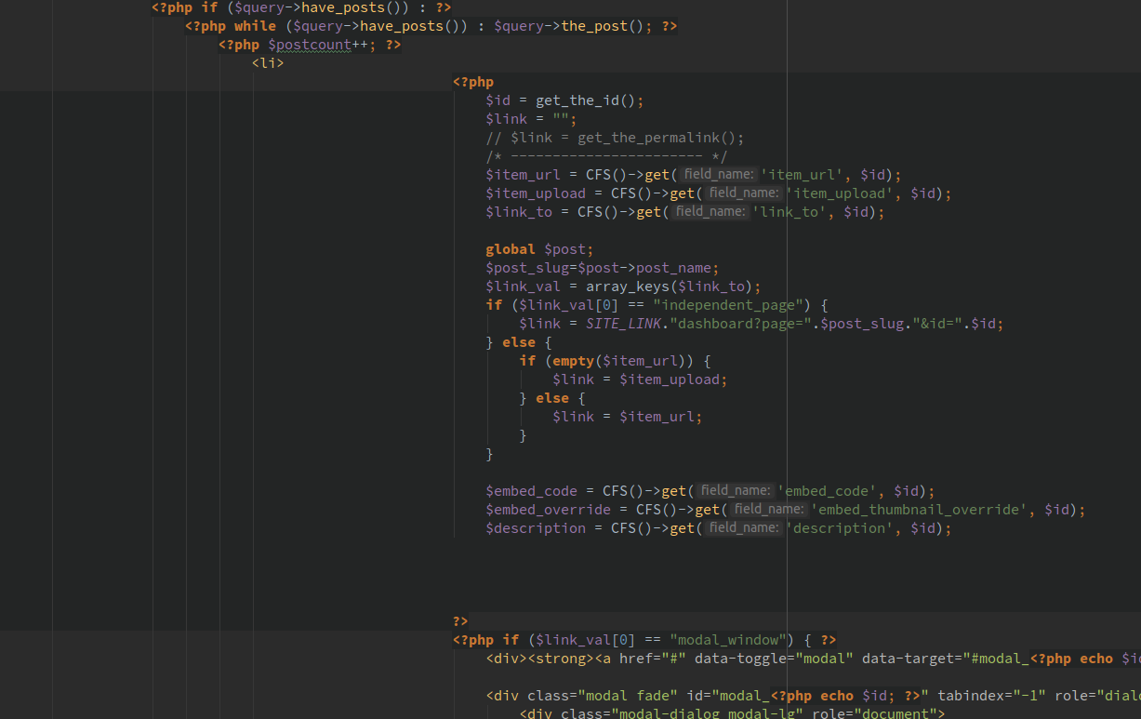
Separate logic from your view layer.
Keep as much logic as possible out of the view layer.

Slide 40
Higher Order Functions/Collection Pipeline
Adam Wathan - Curing the common loop - Laracon EU 2016
https://www.youtube.com/watch?v=crSUWtRYw-M https://adamwathan.me/refactoring-to-collections/
https://github.com/tightenco/collect

Slide 41
Next Steps

Slide 42



Frameworks!
[Laravel](https://www.laravel.com)
Most popular PHP framework for new projects.
Vast community and first party eco-systems.
Ruby On Rails of the PHP world.
[Zend Framework](https://framework.zend.com/)
Maintained by the creators of PHP.
Popular in enterprise applications.
Dedicated Zend Studio IDE for Zend Framework development.
[Symfony](https://symfony.com/)
Composed of several standalone components.
Can be used as a complete framework or individual components can be included separately in almost any PHP project.
Symfony components are used in lots of popular open source PHP software including Drupal and Laravel.

Slide 43
Resources For Learning More
[Laracasts](https://laracasts.com/)
[KnpUniversity[(https://knpuniversity.com/tracks/symfony)
[Test Driven Laravel](https://course.testdrivenlaravel.com)
[Servers For Hackers](https://serversforhackers.com/)

Slide 44
Challenge Problem
https://github.com/damiantw/fake-customer-gateway/blob/master/challenge-problem.md
Package Instructions: https://github.com/damiantw/fake-customer-gateway
Sample Solution: https://damian.lol/albany-can-code/

